Slide 1
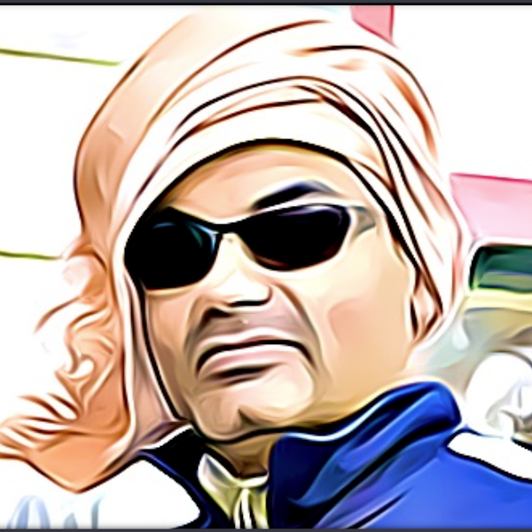
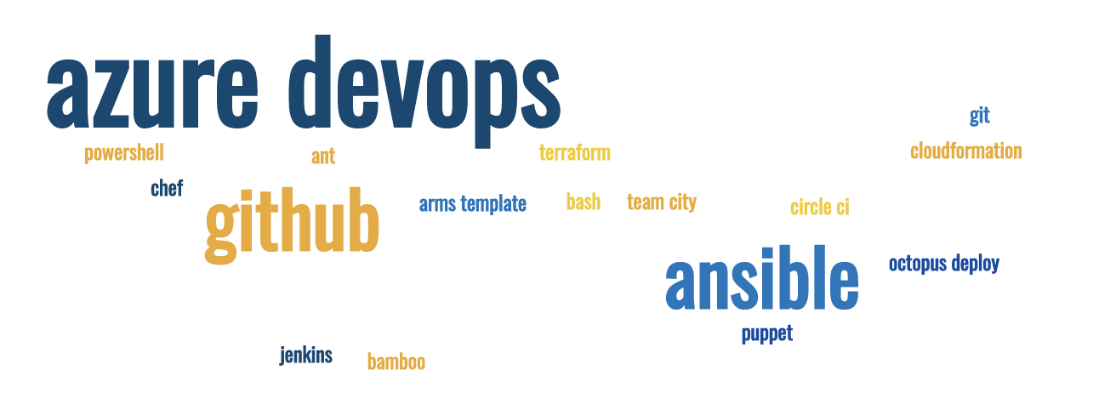
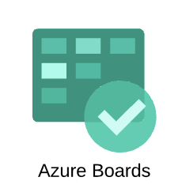



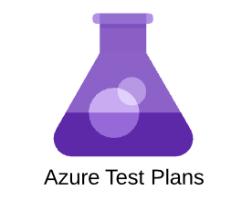
Azure DevOps part 2
Work Item management, Planning, Tracking
Sujit Singh

Slide 2
Agenda
Azure DevOps
Overview
Plan
Build
Test
Release
Build
Repo
Branching
Releases
Example
Azure DevOps

Slide 3
Azure DevOps
Introduction
VSTS (on premises, VS Team System) - 2005
TFS (on premises, Team Foundation Server) - 2008
VSO (Visual Studio Online) – 2013
VSTS –(VS Team Services) – 2015
ADO (Azure DevOps) - 2018
Notes:
Lots of APIs
Az cli support
Great integration with Azure and all other tools,
Extensibility

Slide 4
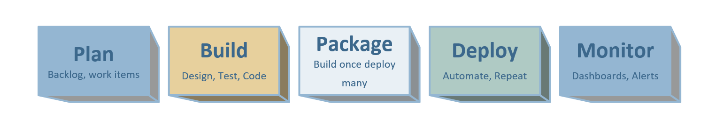





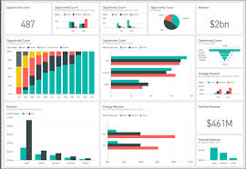




Azure DevOps – Single Tool for delivery

Slide 5
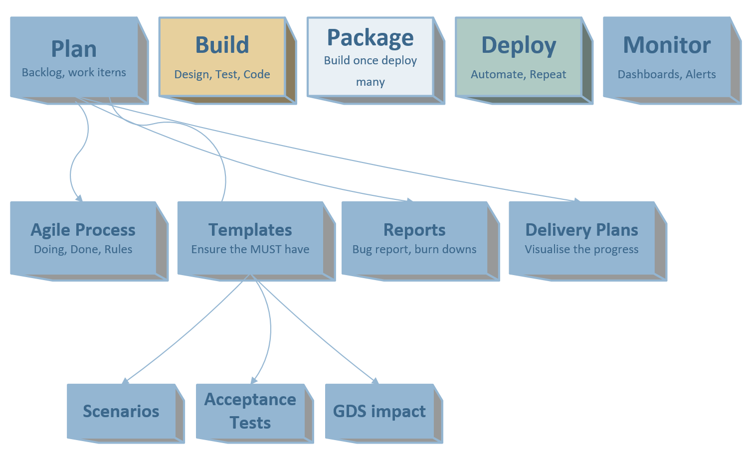
Azure DevOps - Build
Custom Rules

Slide 6
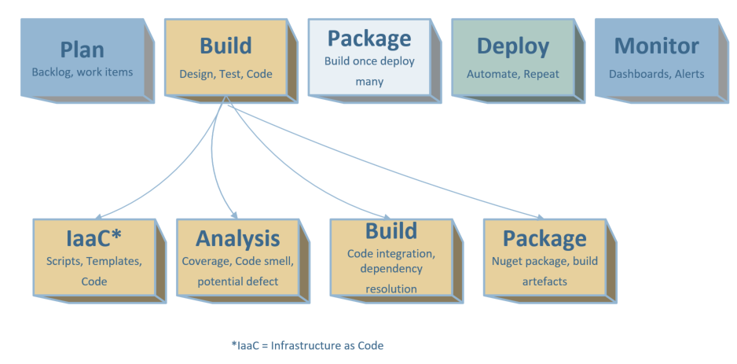
Azure DevOps - Build
Notes:
CI – Not the integration testing. Purely code integration to ring fence bad check ins, highlight code quality and missing tests etc early in the sprint.
Infrastructure as a Code
On-going code analysis and report. Zero tolerance for new code

Slide 7
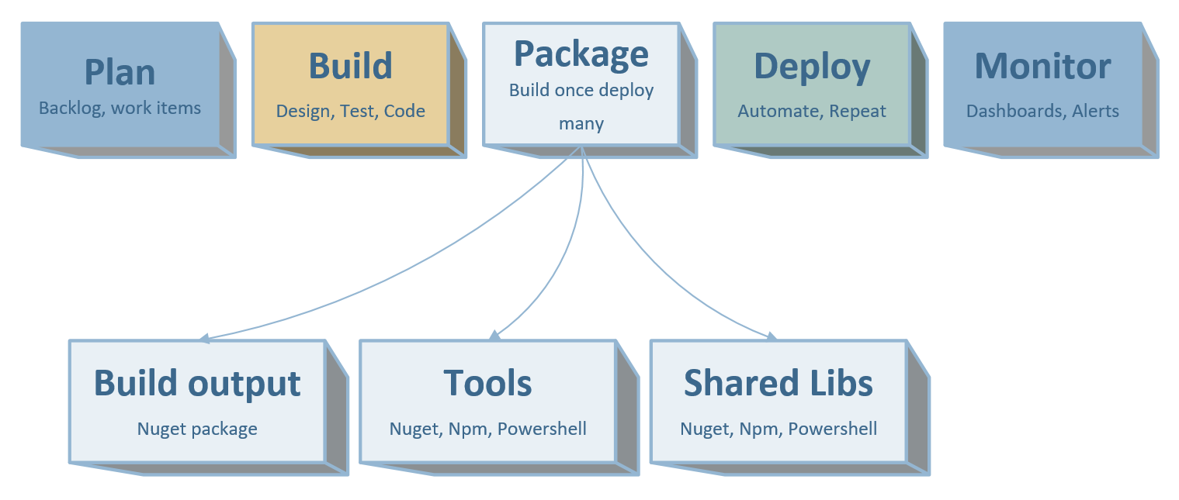
Azure DevOps - Package

Slide 8
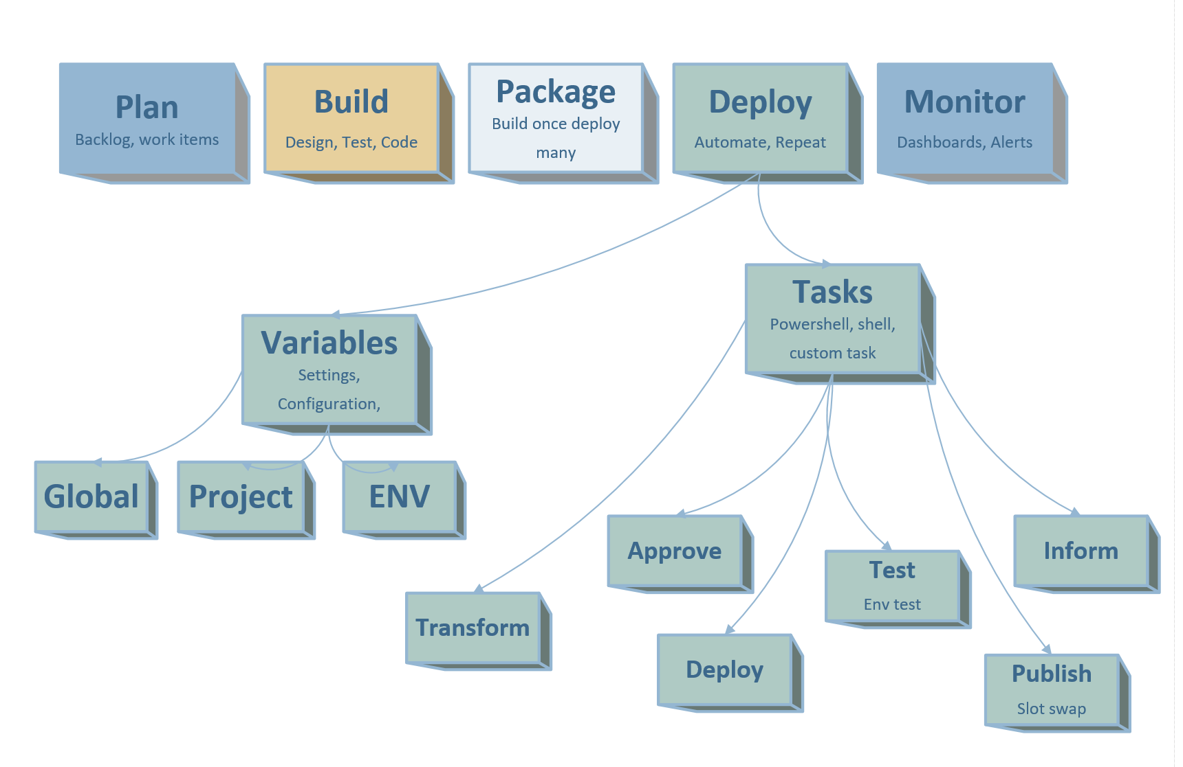
Azure DevOps - Deploy

Slide 9
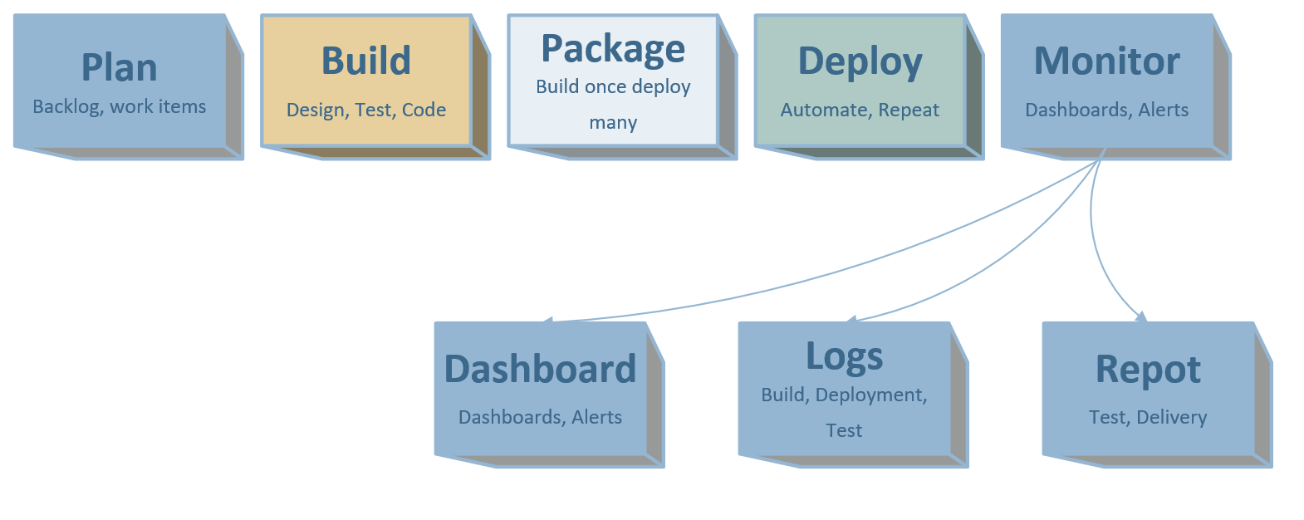
Azure DevOps - Monitor
Notes:
Various dashboards to show the progress of backlog,
Delivery plans
Test reports
Deployment status

Slide 10
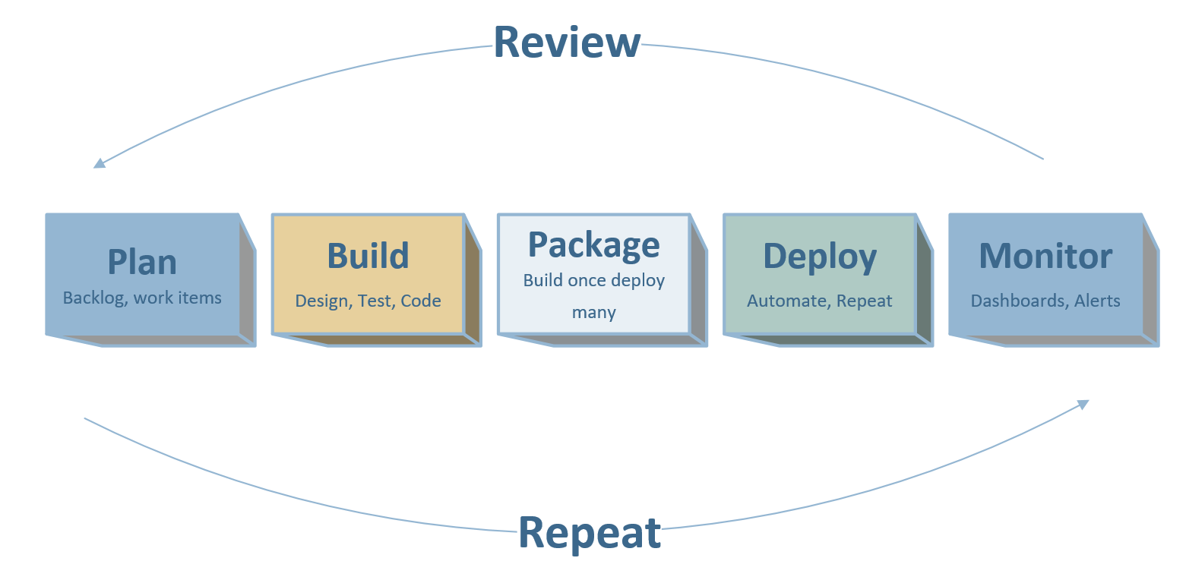
Azure DevOps – Continuous Improvement

Slide 11
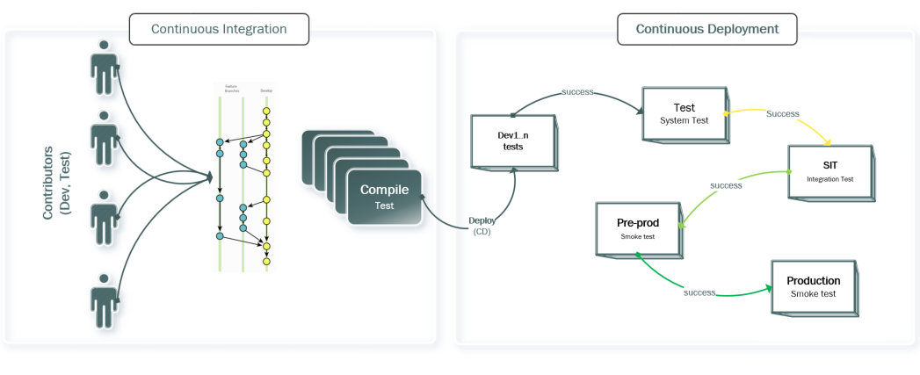
Azure DevOps – Typical deployments
Environments are logically grouped, they can have one or many physical components
Repeatable process, environments can be recreated.
SIT deployment goes through co-ordination between teams
Pre prod and prod deployment usually go through change control

Slide 12
Break
Comments

Slide 13
Example and Demo

Slide 14



New
Create User story
Add initial high-level requirement
Ready
Clear Description updated
Acceptance Criteria
Approved
Team agrees and understand implementation requirement
Estimated
Active
Tasks created
Unit testing
Persona and context provided
Implementation done, tasks closed
Documentation done
Resolved
Closed
Verified
Stakeholders informed
Product Owner
Business Analyst
Product Owner
Engineers
Engineers
Product Owner
New stories can be created by other team members (delegated by PO if agreed)
Approval can be done by Scrum master if PO agrees
Story can be closed by Scrum master if PO agrees

